Slide 1
Atelier GraphQL

Slide 2
Introduction
- Created by Facebook in 2012
- Is Query language for API
Is server-side runtime
No route, only a graph define what can be request, the same for the mutation
Improve client-server requests

Slide 3
Who use GraphQL ?

Slide 4
GraphQL VS REST
Notes:
To illustrate the major differences between REST and GraphQL when it comes to fetching data from an API, let’s consider a simple example scenario:
- In a blogging application, an app needs to display the titles of the posts of a specific user.
The same screen also displays the names of the last 3 followers of that user. How would that situation be solved with REST and GraphQL?

Slide 5
GraphQL VS REST
REST Request :
Notes:
In rest, in most of case it will be necessary to do 3 requests

Slide 6
GraphQL VS REST
GraphQl Query :
Notes:
you’d simply send a single query to the GraphQL server that includes the concrete data requirements.
The server then responds with a JSON object where these requirements are fulfilled.
We can expect to get only the data that we need, no more no less.

Slide 7
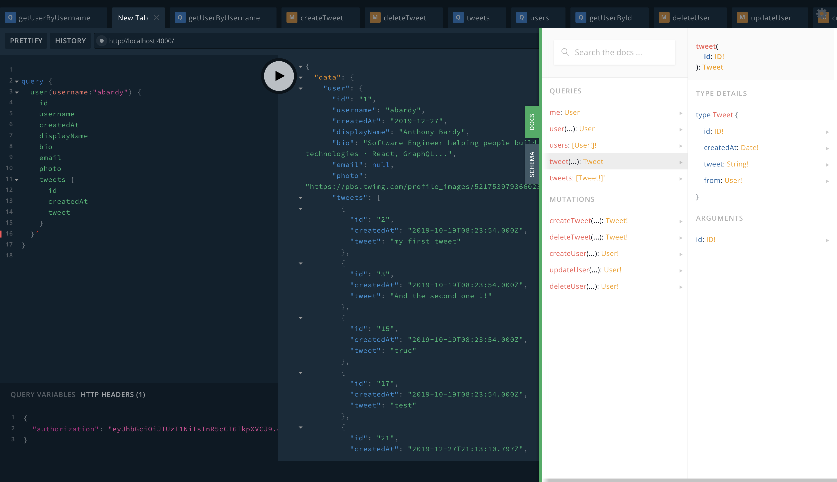
Advantages
- Fetching data with a single API call
- No over and under fetching problems
- Autogenerating API documentation
API evolution without versioning
Detailed error message
- Support C#, Java, Node.Js, Python…
Notes:
Fetching data with a single API call :
As I told you previously, only 1 request allow us to get all of what we need for the user (user, post, follower)
No over and under fetching problems :
We request only what we need no more, no less
Autogenerating API documentation:
With GraphQL UI we can directly see schema the different types, it make easier to see the different queries that we can do

Slide 8

Query example

Slide 9
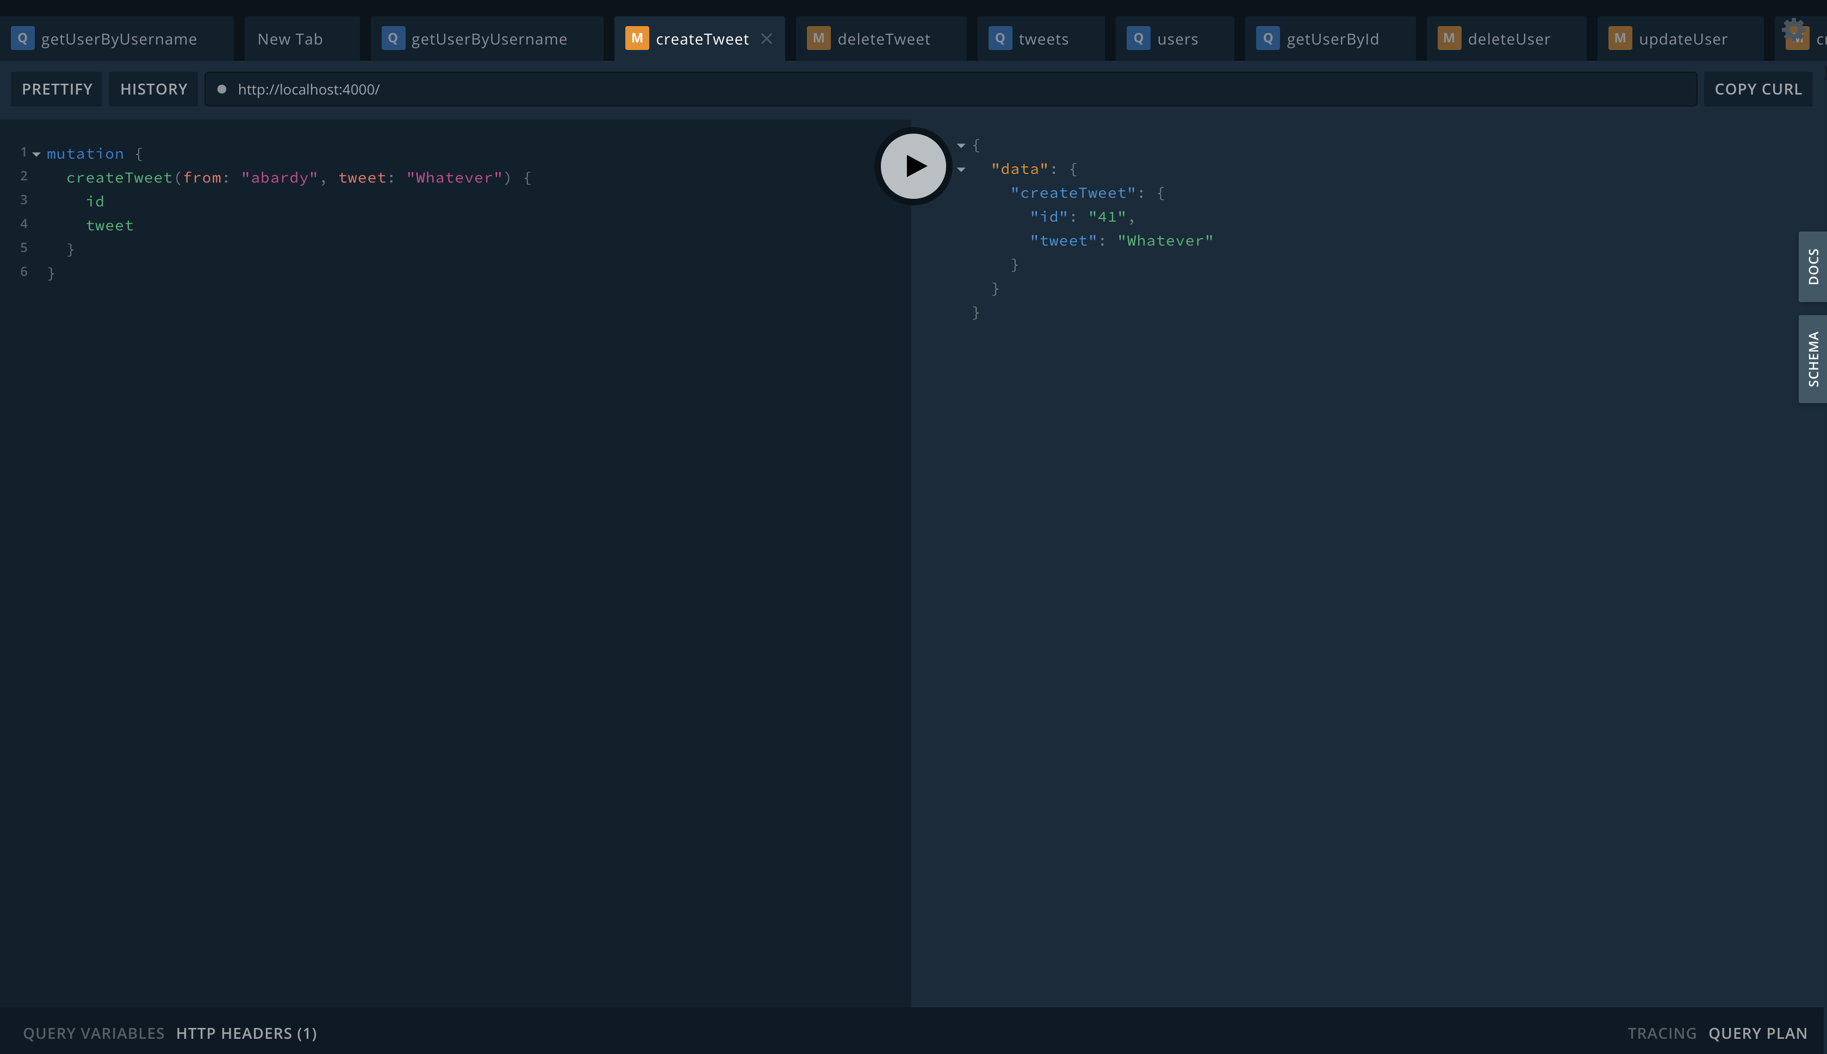
Mutation example

Slide 10
Demonstration

